Slide 1

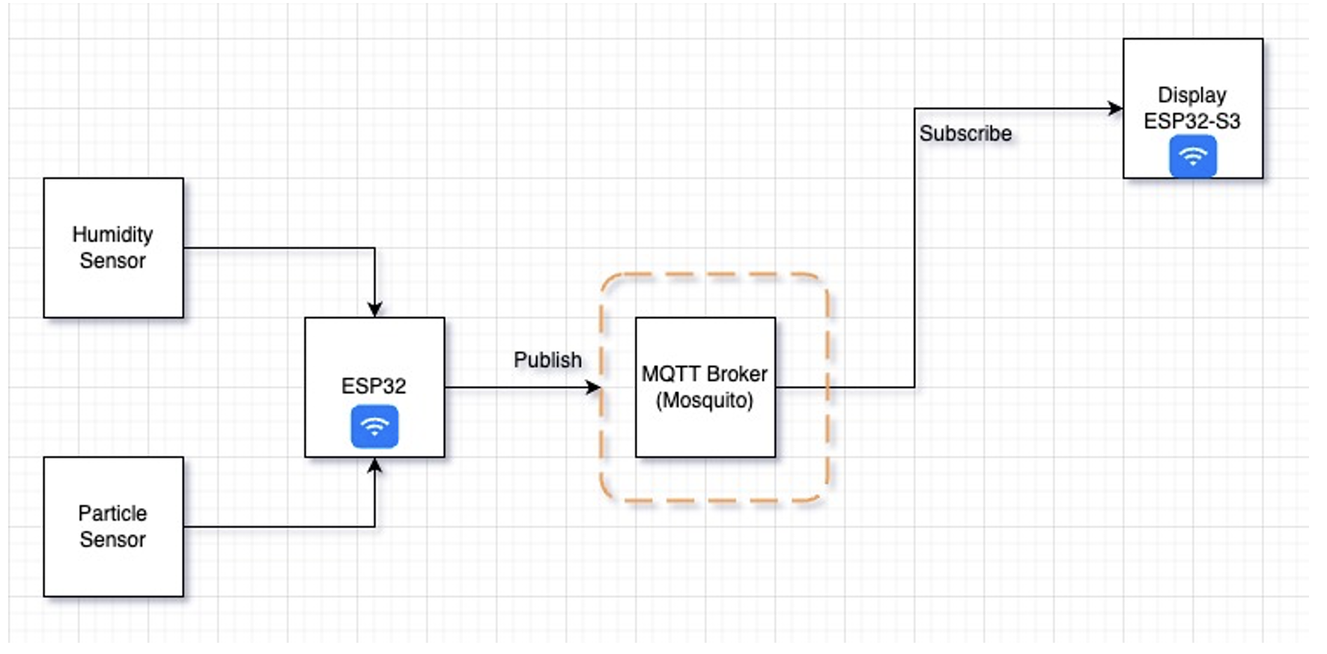
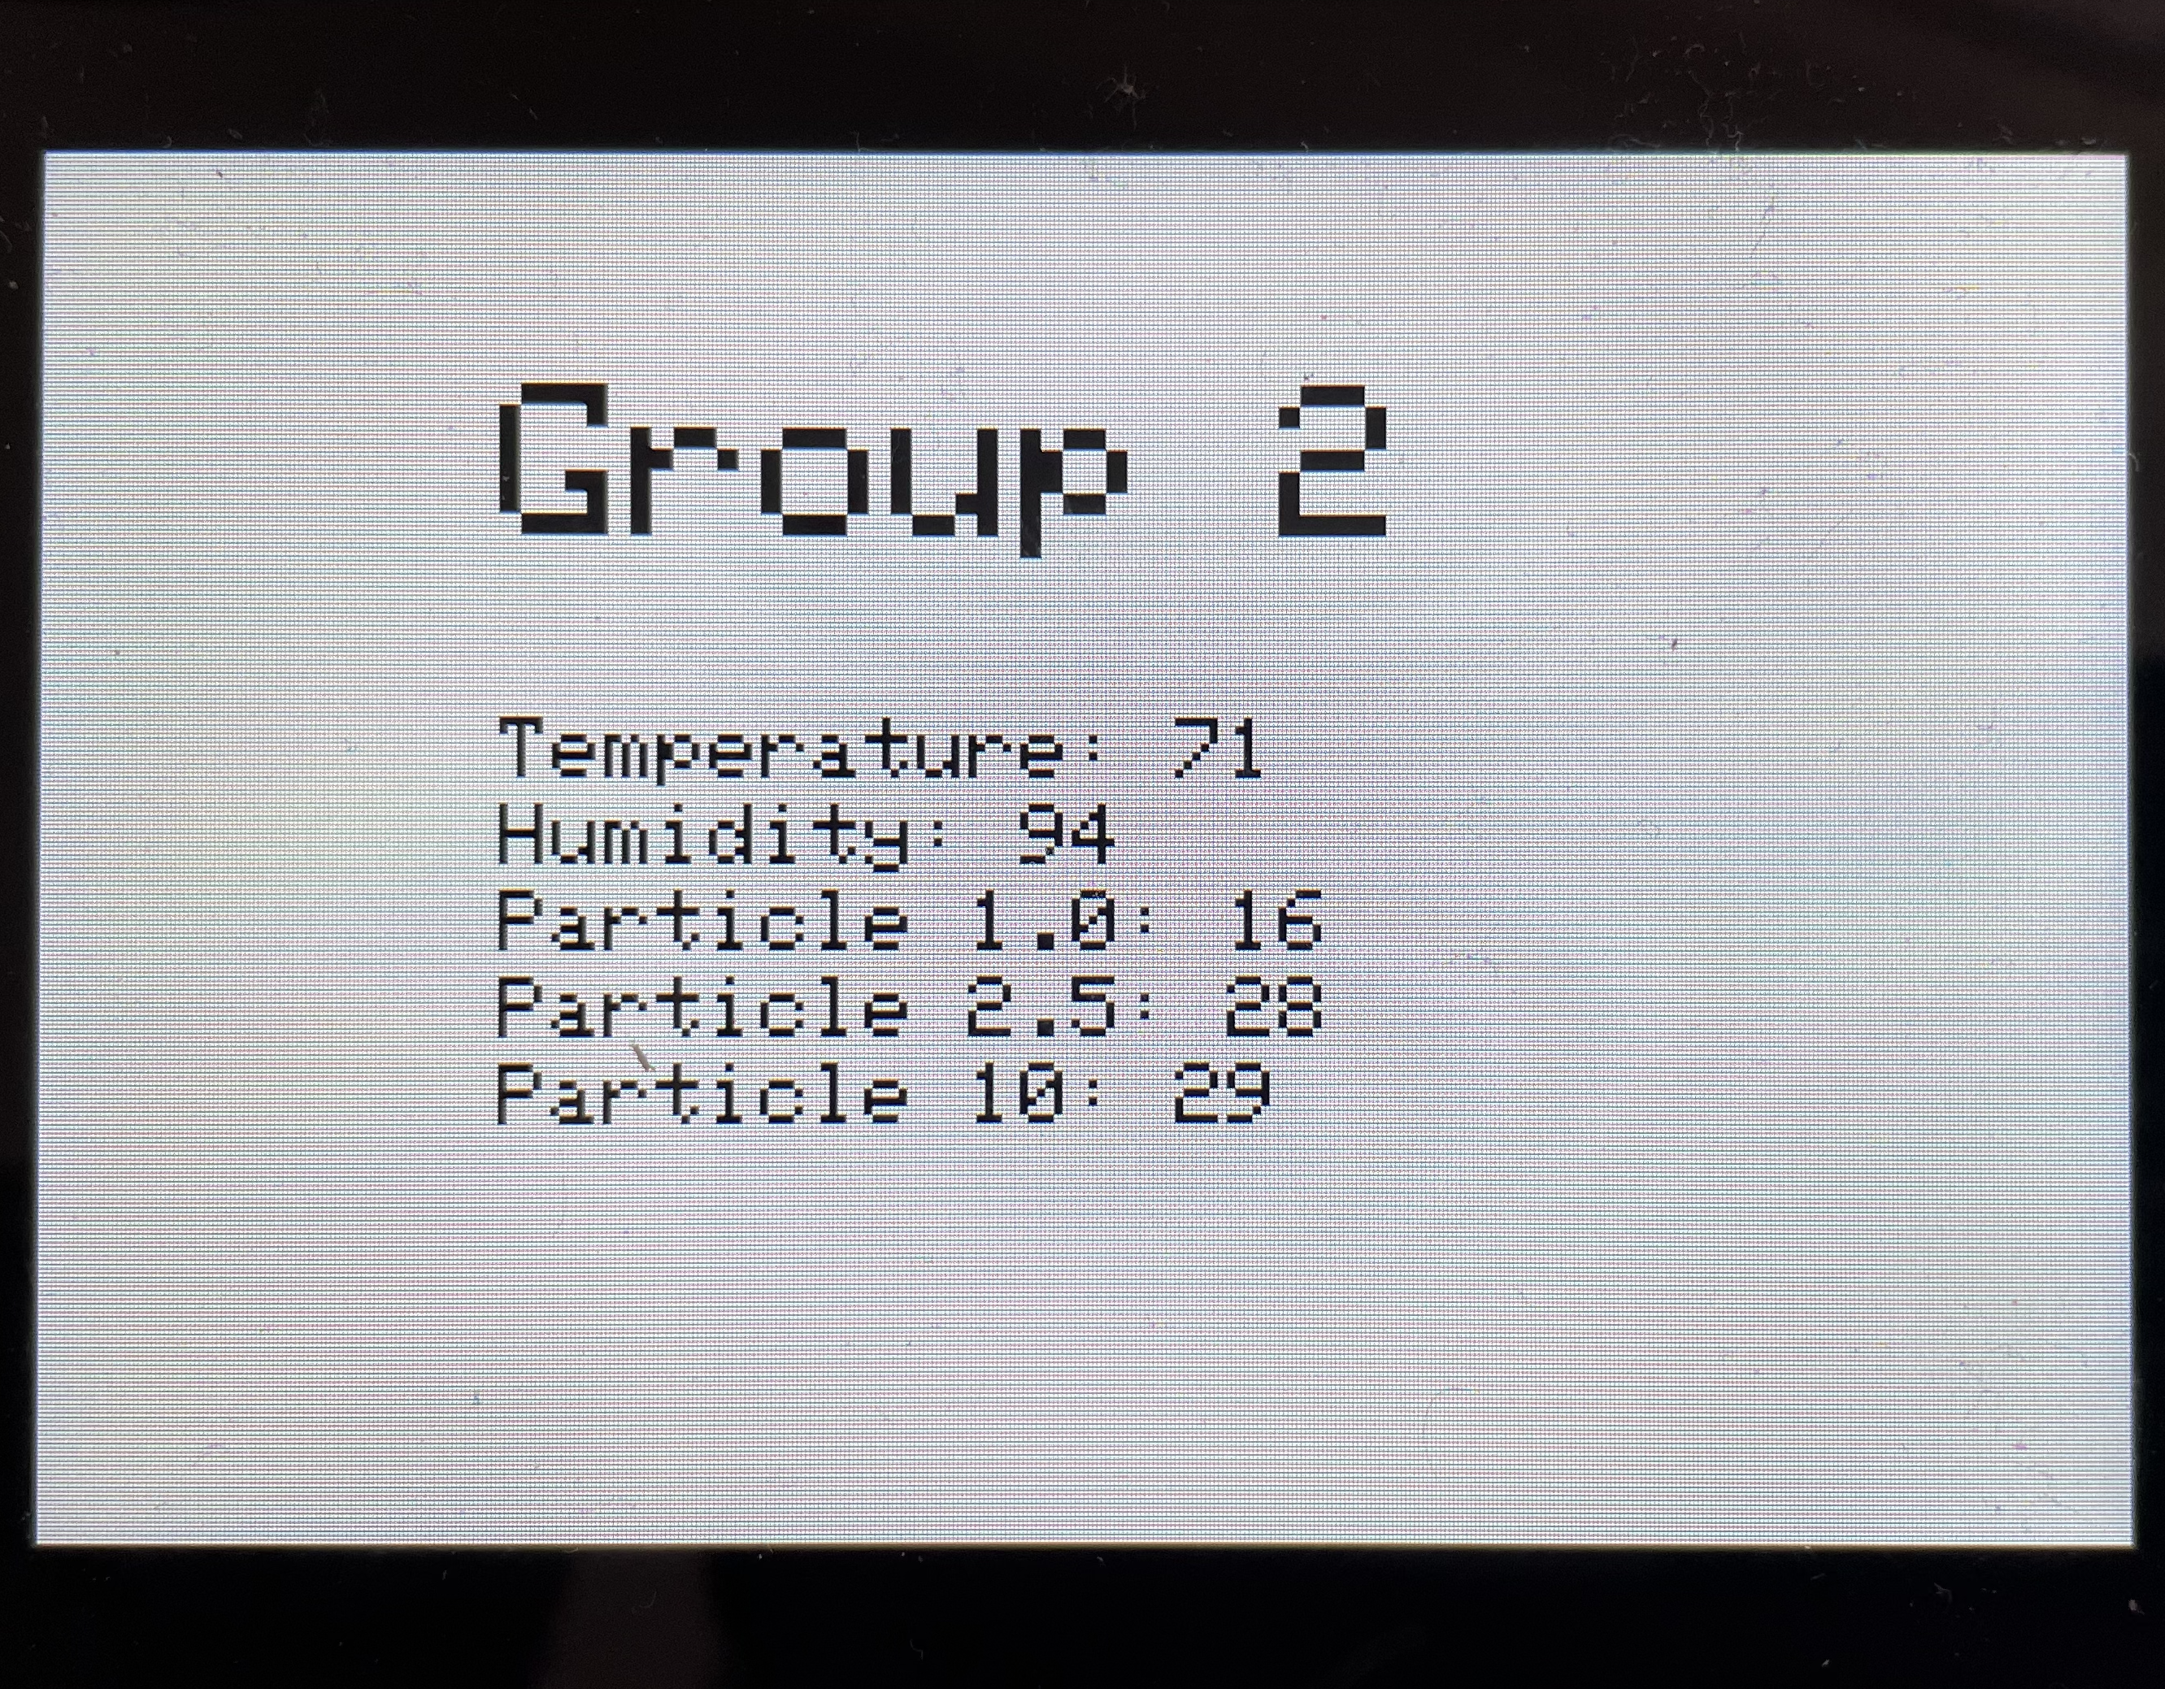


Weather and Particle Monitoring System
Dheeraj Velury, Jyothi Sai Krishna Ravuri, Madhavi Latha Parsa, Manasa Boreddy, Sai Ram Revuri, Prathyusha Pyneni, Tarun Sai Madala, Naga Satish Mediboina
Advisor: Dr. Sejun Song, University of Missouri – Kansas City
MOTIVATION:
In recent years we have seen increased interest in air purifiers and weather applications. The system can be defined as a mechanism for determining the ppm levels and weather accurately. We rely heavily on the weather and particle sensor to accurately measure the required parameters and also to display and store this using MQTT and AWS servers for further analysis.
So, our main motivation is to implement a system which can monitor weather and particles (PPM) in any environment.
MOTIVATION:
CURRENT PROBLEMS
WORKING OF THE MODEL
At times particle sensor gives us a checksum error and turns off automatically If we run it for a long time.
Due to limited documentation about the screen, we are currently unable to utilize functions such as custom layouts and touch screen.
ESP 32 is used as the main senor, and it connects to the Wi-Fi when powered on.
Once Wi-Fi connection is established, it connects to the MQTT broker.
ESP 32 acts as a published, and ESP 32 S3 acts as a subscriber.
ESP 32 reads data from humidity and particle sensors and published the data to the MQTT broker if not null.
Once ESP 32 publishes the data ESP S3 acting as a subscriber will receive the data.
As the received data is validated in the ESP 32 S3 it is displayed on the screen.
Every time ESP 32 S3 receives the data it re-renders the screen.
OUR SOLUTION: Particle sensing
Using particle and weather sensor we measure the ppm and other parameters indoors. It is of low cost, does not require extra hardware requirements.
Main advantage of having a cloud server is that this data can be saved for further analysis when needed and does not require much processing power.
PPM, Temperature and Humidity
Particle 1: It is the particle measuring of pm 1.0 standard
Particle 2: It is the particle measuring of pm 2.5 standard
Particle 3: It is the particle measuring of pm 10.0 standard which detects larger particles in the air.
Temperature: It is the current temperature measurement.
Humidity: Measures the current humidity in the air.
Display and MQTT Broker
Mosquito broker: Lightweight MQTT broker, based on publish/ subscribe model.
AWS: To host MQTT broker on EC2 Instance.
CONCLUSION
IoT Devices:
ESP 32
Particle Sensor
ESP 32 S3 based Screen
Temperature and humidity sensor
Successfully, we are able to show the accurate temperature, humidity and PPM values in the air.
Future work includes more thorough path measuring the various parameters and a more elegant storage solution.
GitHub
Zoom Video link

